Slide 1

S ubject Name: APPLIED CHEMISTRY -1 Unit No:2 Unit Name: POLYMERS
Faculty Name : Mrs. Rupal Agme-Jadhav, (Ph.D.)

Slide 2

Index -
Lecture 1 – Polymers Sub Topic: Rubbers(Introduction)
2
Lecture 2 – Classification Of Polymers, Compunding Of Plastics
4
Lecture 3 – Fabrication Of Plastics
5
Lecture 4 – Preperation,Properties & Uses Of Plastics
6
Lecture 5 – Glass Transition Temprature & Polymers
8
In Medicine & Surgery
Lecture 6 – Conducting Polymer & Industrial Polymer
2
Lecture 7 – Natural Rubber & Drawbacks of Natural Rubbers
4
Lecture 8 –Vulcanization Of Rubber
5
Lecture 9 – Buna-S Or Styrene Rubber Preperation
6
Lecture 10 – Polyurethene Rubber Or Isocyanate Rubber Preperation
8
2

Slide 3

Unit No: 1 Unit name:Applied Chemistry-1
Lecture No: 1 Introduction

Slide 4

Introduction of Polymers
The word polymer is derived from the classical Greek words poly meaning “many” and mers meaning “parts.”
Simply stated, a polymer is a long-chain molecule that is composed of a large number of repeating units of identical structure.
Polymerization :
The process of joining a large number of molecules of monomers to form large molecule of polymer is known as polymerization.
.
4
Notes byMrs. Rupal Agme-Jadhav (Ph.D.)

Slide 5
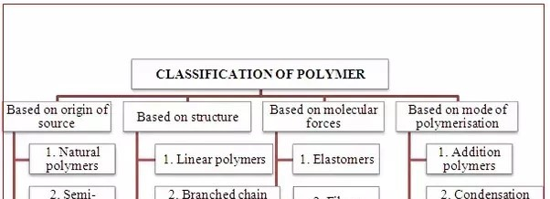
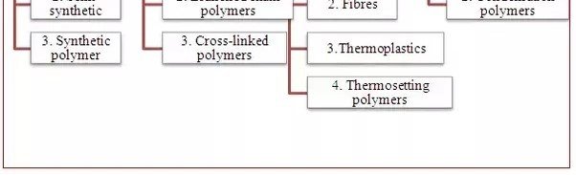

CLASSIFICATION OF POLYMER
5
Notes by: Mrs. Rupal Agme-Jadhav (Ph.D.)

Slide 6
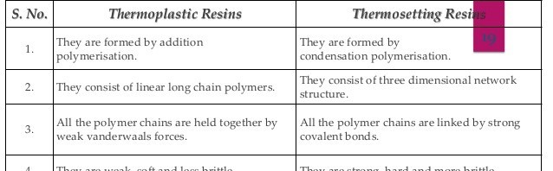
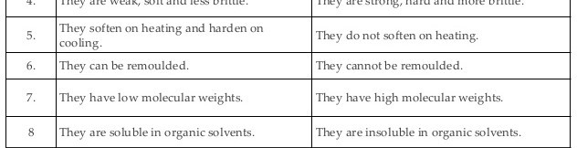
CLASSIFICATION OF POLYMER
5
Notes by: Mrs. Rupal Agme-Jadhav (Ph.D.)

Slide 7


Addition polymerization
Condensation polymerization
The monomer must have at least one
The monomer must have at least two
multiple bond.
identical or different functional groups which can interact with each other to undergo condensation.
It is a fast process.
It is an exothermic process.
It is a slow process.
It is an endothermic process.
It is generally produces linear polymers.
It produces three dimensional cross linked polymers.
Mostly thermoplastics are obtained by this method.
Give rise to thermosetting plastics.
Eg. PVC
Eg. Polyesters , nylons.
5
Notes by: Mrs. Rupal Agme-Jadhav (Ph.D.)

Slide 8
COMPOUNDING OF PLASTICS
It is the process of mixing certain additives in required proportions to the main plastics in order to modify certain existing properties & to incorporate new properties , so that new plastic obtained is commercially exploited.
The main ingredients (additives) used in the process of com[pounding are as :
Binders ii) Fillers iii) Plasticizers iv) Catalyst
iv) Stabilizers v) Lubricants viii) Dyes & pigments.
8
NotesMrs. Rupal Agme-Jadhav (Ph.D.)

Slide 9
COMPOUNDING OF PLASTICS
i) Binders :
Generally plastic is classified depending on the type of binder used for its manufacture.
The main function of binder is to hold the other constituents of the plastic together.
The binder used may be natural or synthetic resins or cellulose derivatives.
ii) Fillers : They reduce the cost of the plastics.
They impart better tensile strength hardness of the plastics.
Eg. Carborundum , quartz etc.
9
Notes by: Prof. Rupal Agme-Jadhav (Ph.D.)

Slide 10
COMPOUNDING OF PLASTICS
iii) Plasticizers :
The important function of plasticizer is to improve plasticity and flexibility, so as to reduce the tempreature and pressure required for moulding.
Most commonly used plasticizers are vegetable oils, camphor, triphenyl phosphate etc.
iv) Catalyst :
Accelerators are added in case of thermosetting plastics to increase the polymerization of fusible resin during moulding process.
Eg: hydrogen peroxide, benzoyl peroxide.
10 Notes by: Mrs. Rupal Agme-Jadhav (Ph.D.)

Slide 11
COMPOUNDING OF PLASTICS
v) Stabilizers :
To improve the thermal stability during processing.
Eg. Alkaline earth oxides, organometallic salts etc.
vi) Lubricants :
These additives promote a good finish to the plastic materials, in addition to improving the flow characteristics and friction reduction in the processing machines.
Eg: Waxes, oils, oleates etc.
11 Notes by: Prof. Rupal Agme-Jadhav (Ph.D.)

Slide 12
COMPOUNDING OF PLASTICS
vii) Dyes & pigment :
They are added for providing decorative colours to the plastic.
The main colouring materials are organic dyestuffs and opaque inorganic pigments.
12 Notes by. Mrs. Rupal Agme-Jadhav (Ph.D.)

Slide 13
Unit No: 1 Unit name:Applied Chemistry-1
Lecture No: 2 Fabrication Of Plastics

Slide 14

FABRICATION OR MOULDOING OF PLASTICS
Fabrication or moulding of plastics is the technique of giving desired shape to the plastic with the help of mould.
This technique involves fabrication of plastic under heat and pressure and is applicable to both the types of resins i.e. thermosetting & thermoplastics.
Compression Moulding
Injection Moulding
Transfer Moulding
Extrusion moulding

Slide 15
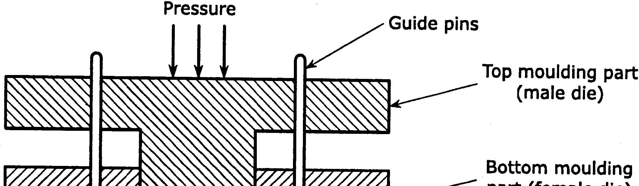
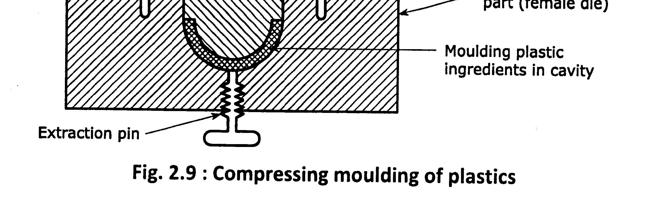
FABRICATION OR MOULDOING OF PLASTICS

Slide 16
FABRICATION OR MOULDOING OF PLASTICS
1. Compression Moulding
This method is applicable to both thermoplastics & thermosetting resins.
In this method a synthetic plastic material that has to be moulded is mixed with filler and other ingredients in proper proportions and then placed in the mould.
The equipment consist of lower moulding part & top moulding part.
The top moulding part is then placed over bottom moulding part in which predetermined plastic ingredients are taken.

Slide 17
FABRICATION OR MOULDOING OF PLASTICS
1. Compression Moulding
Then it is heated with simultaneous application of the pressure according to specification. ( High pressure of 100 to 500 kg/cm2 and temp. 100 to 200c.). The cavities get filled with plastics. Once the moulding is over, the material withdrawn after cooling.
Finally curing is done either by heating or cooling.
After this process is over , the moulded article is taken out by opening the mould parts.
Notes by: Prof. Rupal Agme-Jadhav (Ph.D.)

Slide 18
FABRICATION OR MOULDOING OF PLASTICS
1. Compression Moulding
Application:
Method is equally applicable for both thermosetting and thermoplastic polymer based composites.
2. A very wide application spectrum ranging from kitchen goods to automobiles, toys, electrical items and aeroplane part.
Advantages:
It has high speed production.
It has low loss of materials.

Slide 19
FABRICATION OR MOULDOING OF PLASTICS
1. Compression Moulding:
Limitation :
As a large number of cavities can not be filled simultaneously, there is limitation design of articles to be moulded.

Slide 20
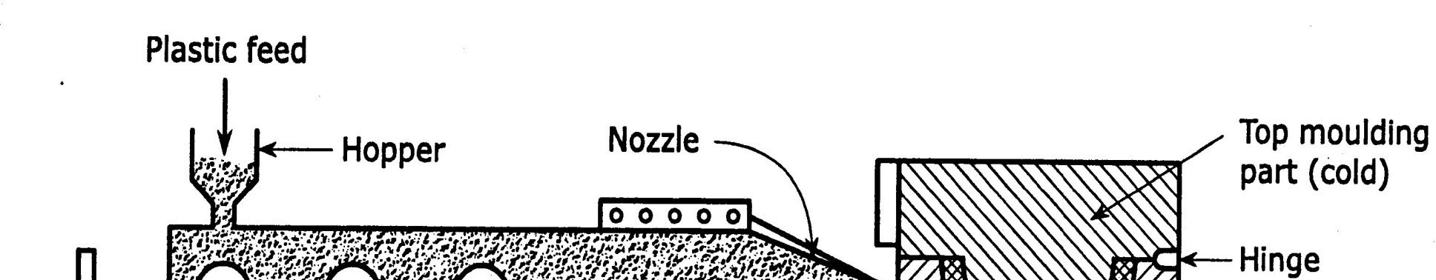
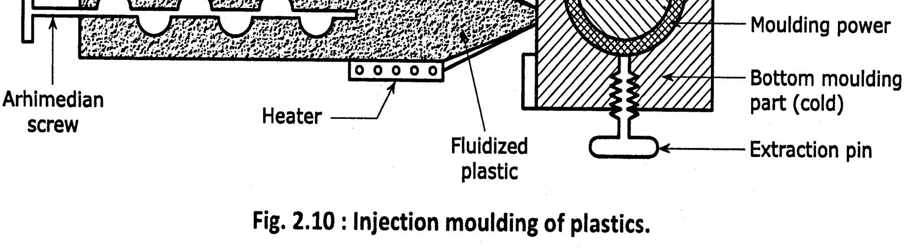
FABRICATION OR MOULDOING OF PLASTICS
20

Slide 21
FABRICATION OR MOULDOING OF PLASTICS
1. Injection Moulding:
This method is applicable to thermoplastic resins.
The plastic materials with compounding ingredients in proper proportion is taken in a tube through hopper.
The tube is electrically heated , till the material completely melts.
The molten material is pushed into mould cavity through nozzle with the help of archimedian screw.
The temperature at the nozzle is increased (between 130-120c) which makes plastic fluid and is injected in the mould.
Moulded articles is ejected mechanically without any deformation.

Slide 22
FABRICATION OR MOULDOING OF PLASTICS
1. Injection Moulding:
Application :
This method is applicable to shape the articles like telephones, buckets, dustbins, bottles etc.
Advantages :
It is widely used for moulding of thermoplastics.
It has high speed production.
It has low finished cost. Limitation :
A large number of cavities can not be filled simultaneously, there is limitation of design of articles to be moulded.

Slide 23
FABRICATION OR MOULDOING OF PLASTICS
3. Transfer Moulding:
This method is applicable for thermosetting materials.
In this process principle of injection moulding is applicable.
The equipment used consists of electrically heated tube having narrow opening called orifice fitted with plunger.
Then the predetermined quantity of plastic ingredients is taken in the tube.
The tube is electrically heated till the material is melts.
The plastic material is pushed into the mould cavity with the help of plunger

Slide 24
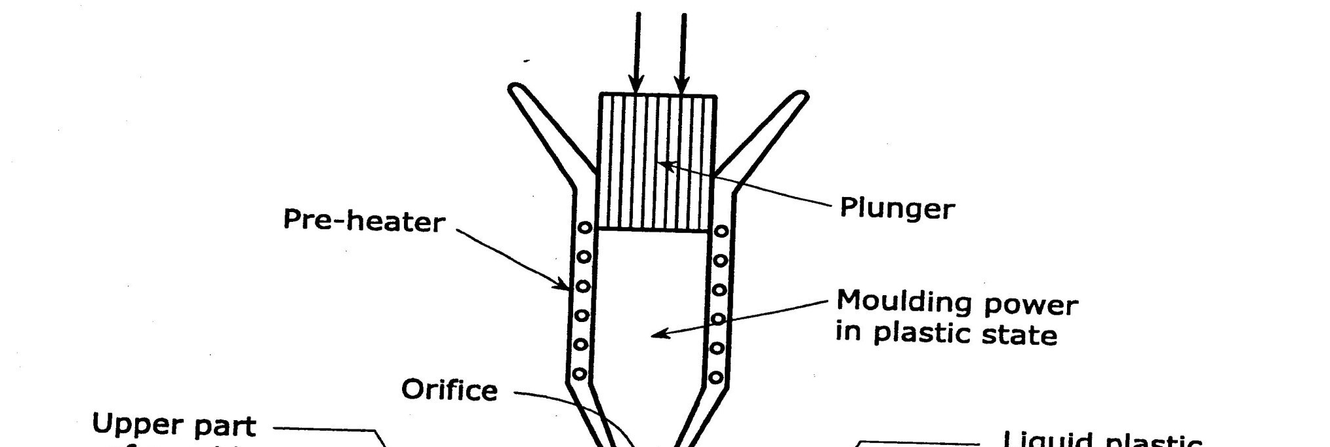
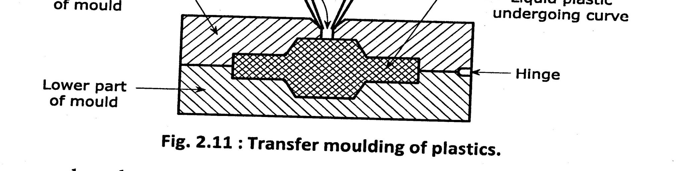
FABRICATION OR MOULDOING OF PLASTICS

Slide 25
FABRICATION OR MOULDOING OF PLASTICS
3. Transfer Moulding:
Due to friction developed at the orifice, the temp. of the material rises to such an extent that the moulded materials becomes a liquid and flows into the mould.
Then the moulded articles is ejected mechanically. Application :
This method is applicable to shape the articles like electronic components, pins, connectors, coils.
Advantages :
Articles free from flow marks are produced.
The article produced have greater mechanical strength.

Slide 26
FABRICATION OR MOULDOING OF PLASTICS
4. Extrusion Moulding:
Extrusion moulding is applicable to thermoplastic resins.
It is mainly used for continuous moulding of thermoplastic materials into articles of uniform cross section like cables, wires, rods, sheets etc.
There are two ways in which this method can be carried out.
Vertical Extrusion Moulding : For cables , wires etc.
Horizontal Extrusion Moulding : For rods, pipes, sheets etc.

Slide 27
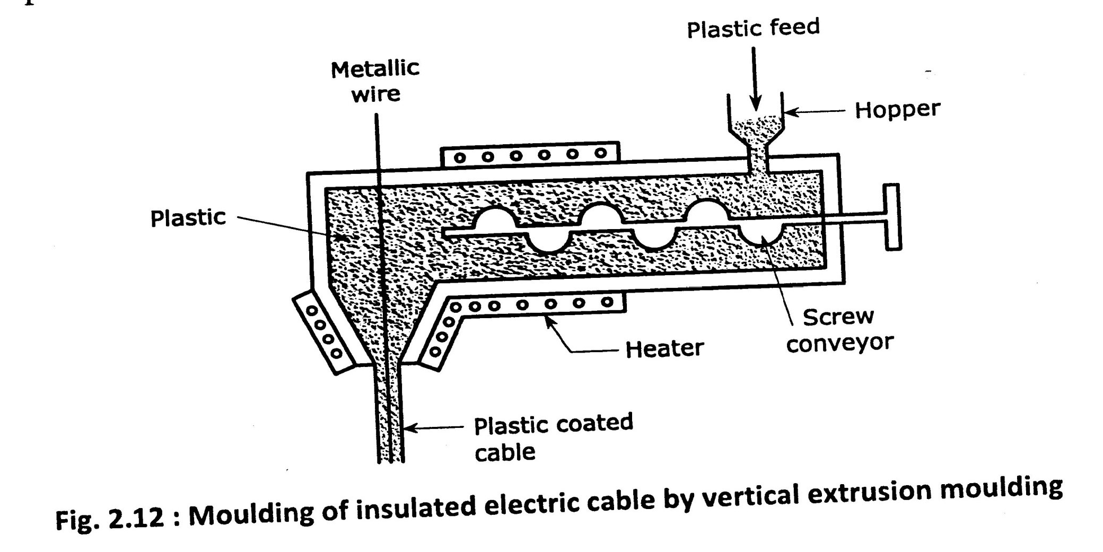
FABRICATION OR MOULDOING OF PLASTICS

Slide 28
FABRICATION OR MOULDOING OF PLASTICS
4. Extrusion Moulding:
In this method, predetermined quantity of plastic ingredients are heated to plastic condition & then pushed by screw conveyor into die having required outer shape of articles to be manufactured.
Then the finished product is taken out is cooled by atmospheric exposure and spraying water.
Application:
This method is applicable to shape the articles like tubes, rods, electric cables etc.

Slide 29
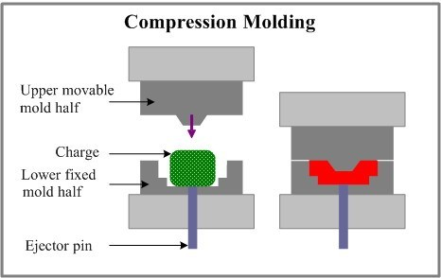
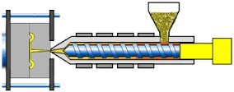
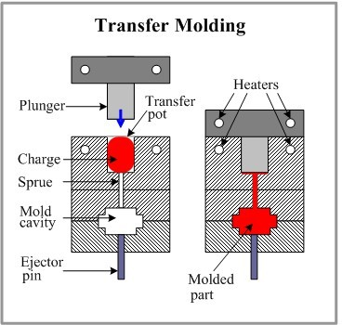
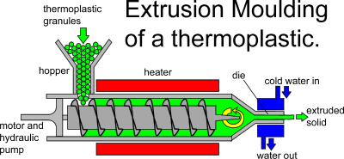

Slide 30


Unit No: 1 Unit name:Applied Chemistry-1
Lecture No: 4
Properties & Preperations Of Plastics

Slide 31
Properties & Uses Of Plastics
Properties of plastics
Phenol formaldehyde presence set to rigid, infusible and insoluble solids
They posses resistance to scratch and water.
They posses excellent electrical insulating character.
Light weight
It can acquire any desired shapes
Easy to fabricate.
Good resistance to solvents, chemicals.

Slide 32

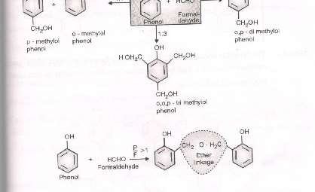
PREPERATION OF PLASTICS
1. Phenol-Formaldehyde Plastic
It is prepared by condensing phenol with formaldehyde in presence of acidic or alkaline catalyst. The initial reaction results in formation of o- and p-hydroxymethyl phenol which reacts to form linear polymer novolac.

Slide 33
Phenol-Formaldehyde Plastic
Properties:
Phenol-Formaldehyde resins set to rigid, infusible and insoluble solids.
They posses resistance to scratch and water.
They are resistant to non-oxidizing acids, salts and many organic solvents, but get attacked by alkalis because of the presence of free hydroxyl groups in their structures.
They posses excellent insulating charcater.

Slide 34
Phenol-Formaldehyde Plastic
Uses:
For making moulded articles like telephone parts, cabinet for radio and T.V. etc.
For impregnating fabrics, wood and paper.
For making electric insulator parts like switches,plugs,switch boards, heater handles,etc.
As a binder for grinding wheels.
Used in paints and varnishes.
For making bearing used in shafts.
1.
Notes by: Mrs. Rupal Agme-Jadhav (Ph.D.)
P

Slide 35
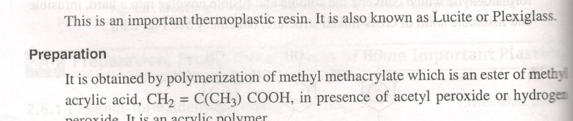
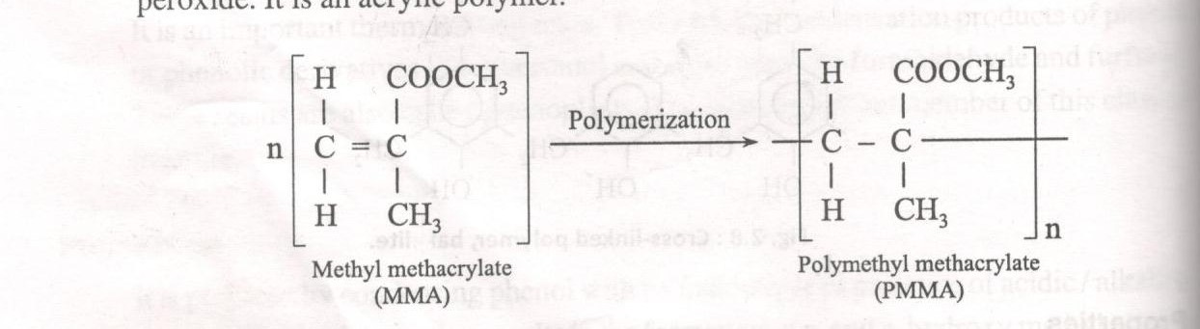
Polymethyl Methacrylate (PMMA)
Polymethyl Methacrylate(PMMA)

Slide 36
POLYMETHYL METHACRYLATE (PMMA)
Properties:
It is hard, fairly rigid material with a high softening point of about 130-140C.
It has low starch-resistance.
It has high optical –transparency.
It ha low chemical resistance to hot acids and alkalis Uses:
For making lenses, optical parts of instruments,air- crafts,light fixtures,etc.
As it is more transparent than glass, it is used for making window glasses.
It is found in paints.

Slide 37
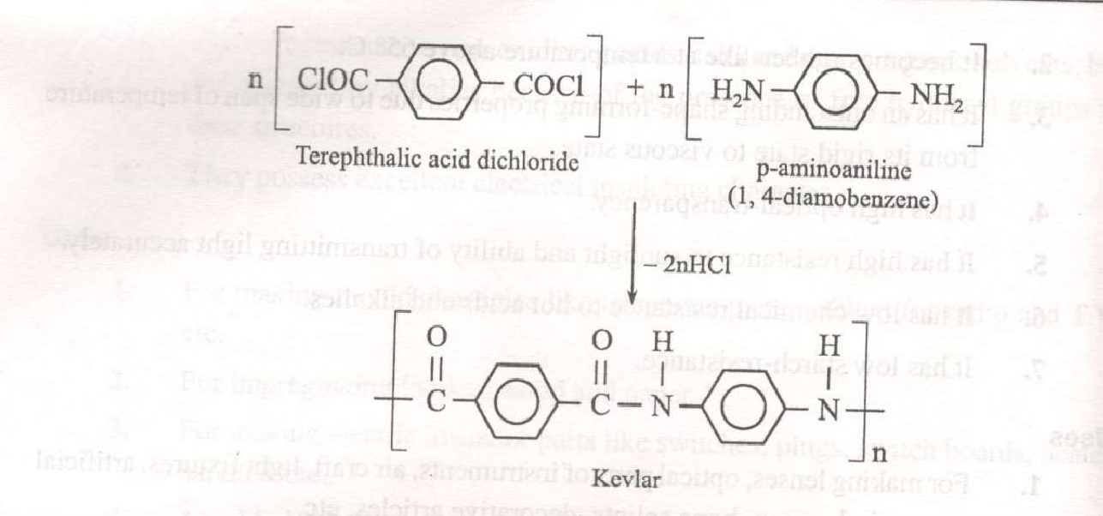
Kevlar(Poly Paraphenylene Terephthalamide)
It is prepared by polycondensation between aromaticdichloride like terepthalic acid dichloride and aromatic diamines like 1,4-phynylene diamine.

Slide 38
Kevlar(Poly Paraphenylene Terephthalamide)
Properties:
It does not lose its strength even at-196C.
It has high heat stability and flexibility.
It does not loose its strength even at low temperature. Uses-
It is used in aerospace and aircraft industry.
It is use for the preparation of rope, cable, protective clothing, bullet proof vest, motorcycle helmets and other high performance material.

Slide 39
POLYMERS IN MEDICINE AND SURGERY
Biomedical Polymers :
Biomaterials are materials that can be implanted in the body or used in the diagnostic, surgical & therapeutic applications without causing adverse effect on blood and other tissues.
They are developed from metal, ceramics & polymers.

Slide 40
POLYMERS IN MEDICINE AND SURGERY
Characteristics of Biomedical Polymers :
They should have optimum physical & chemical properties.
They should be fabricated into any desire shape.
They should not destroy cellular elements blood , enzymes.
It should be bio-compatible.
They can be easily sterilized with no alteration in properties.

Slide 41
POLYMERS IN MEDICINE AND SURGERY
APPLICATIONS OF BIOMEDICAL POLYMERS
Sr. No. 1.
2.
3.
Polymers Polyethylene Polypropylene Polyvinyl chloride
Applications Disposable syringes
Heart valves, blood filters Disposable syringes
4.
5.
6.
7.
PMMA Contact lenses
Polyalkyl sulphones Membrane oxygenator
Silicone rubber Polyurethane
Heart valves, drain tubes Heart valves, blood filters

Slide 42
GLASS TRANSITION TEMPRATURE
The glass transition takes place in amorphous i.e. glassy polymers.
Even when the glass in liquid state is cooled, crystallization does not take place. This is because the polymers are not able to rearrange themselves into a 3-d,long-range and properly ordered structure.
On cooling the glass transition corresponds to increase in viscosity, a gradual transformation from a liquid to a rubbery material and finally to a rigid solid.
The temperature at which the polymer experience the transition from rubbery to rigid state is termed as the glass transition temperature (Tg).
When a rigid glass at a temperature below Tg is heated, the sequence of events occur in reverse order.
42

Slide 43
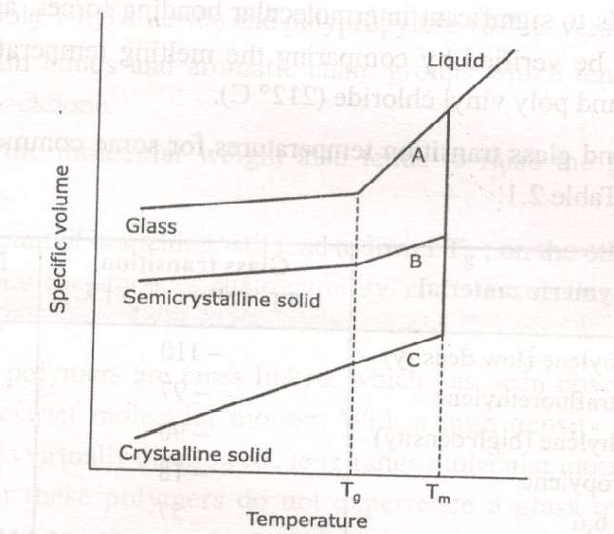
Notes by: Mrs. Rupal Agme-Jadhav (Ph.D.)

Slide 44
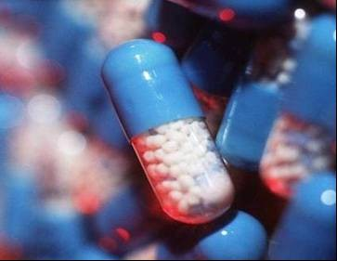
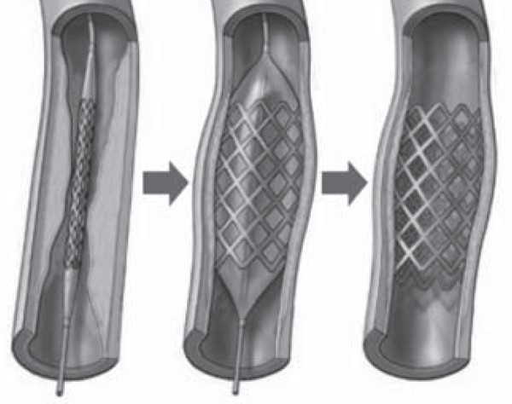
POLYMERS IN MEDICINE AND SURGERY
These are the materials that can be implanted in the body to provide special prosthetic functions or used in diagnostic surgical and therapeutic applications, without causing adverse effect to blood and other tissues.
Bio-materials are developed from metals, ceramic and polymers .Use of bio-materials made from polymers is increasing day by day with the expansion of polymer industry.
44
Notes by: Mrs. Rupal Agme-Jadhav (Ph.D.)

Slide 45
CHARACTERISTICS OF BIO-MEDICAL POLYMER
A bio-medical polymer should posses the following characteristics:
Purity and reproducibility
Optimum physical and chemical properties
Should be fabricated into desired shape or form ,without being degraded and adversely affected in its properties.
Easy sterilization with no alteration in its properties.
Biopolymers that are to come in contact with blood and tissue of the body must not destroy cellular elements of blood,enzymes,protiens,produce toxic and allergic reactions and deplete electrolytes present in the body.
45
Notes by: Prof. Rupal Agme-Jadhav (Ph.D.)

Slide 46
Unit No: 1 Unit name:Applied Chemistry-1
Lecture No: 6
Conducting and Industrial Polymers

Slide 47
Conducting polymers
Most of the polymeric materials are poor conductors of electricity due to unavailability of large number of free electrons. The basic requirements for conducting polymer is the formation of continuous conjugation through polymer chain.
Different types of conducting polymers are as follows:
1. Intrinsically conducting polymers: It is a polymer whose backbone or associated group consist of delocallised electron pair or residual charge.In an electric field,conjugated pi-electrons of the polymer get exited ,and hence can be transported through the solid polymeric material. Some common examples are polymers, polyaniliene, polypyrrole etc..

Slide 48
Conducting polymers
Extrinsically conducting polymers: It is a polymer whose conductivity is due to presence of externally added ingridients in them.
Conductive elements-filled polymers: It is a resin filled with conducting elements such as carbon black or metal oxides in which the polymer acts as a binder to hold the conducting elements, along with conductivity these polymers are low in cost,light in weight,mechanically durable and strong.

Slide 49
Conducting polymers
4. Blended conducting polymer: It is obtained by blending a conventional polymer with conducting polymer. Such polymer posses better physical, chemical and mechanical properties.
It can be also done by p-doping and n- doping methods.

Slide 50
INDUSTRIAL POLYMERS
1. POLYETHENE Properties:
It is rigid ,waxy, non polar material, highly tensile and flexible.
Uses:
For making high frequency insulators parts, bottle caps, flexible bottles, toys,etc.
50

Slide 51
INDUSTRIAL POLYMERS
2. Polyvinyl chloride(PVC):
Properties:
They are chemically inert,resistant to light
,atmospheric oxygen.inorganic acid ,high softening point , greater stiffness and rigidity.
Uses:
It is used for making sheets used in tanks lining,light fittings,safety helmets, refrigerator components,tyres,etc

Slide 52
INDUSTRIAL POLYMERS
3. Polycarbonates:
Properties:
It has high impact and tensile strength. Uses:
For preparing moulded domestic wear, housing for apparatus and electrical insulator in electronics industry.

Slide 53
Unit No: 1 Unit name:Applied Chemistry-1
Lecture No: 7 Natural Rubber

Slide 54
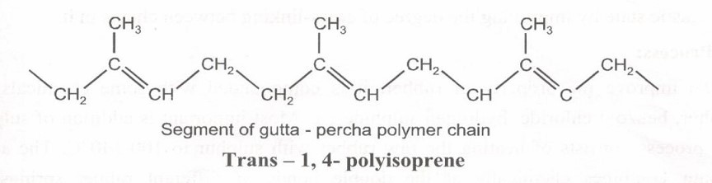
NATURAL RUBBER
It is obtained from the plant known as hevea brasiliensis which is originally from brazil and is cultivated in plantations mainly in tropical regions in south east, specially in Malaysia ,Indonesia ,india , Thailand
,etc. The source of natural rubber is milky liquid known as latex, which is a suspension containing very small particles of rubber.
54
Notes by: Prof. Rupal Agme-Jadhav (Ph.D.)

Slide 55
PROPERTIES AND DRAWBACKS OF
NATURAL RUBBER
As it becomes soft at higher temperature and brittle at lower temperature , can be used in temperature range of 10-60’C
It is weak with very low tensile strength .
It has large water absorption capacity .
It is non –resistant to non polar solvent like vegetable and mineral oil, gasoline, benzene etc.
It is attacked by oxidizing agent like nitric acid, sulphuric acid
,chromic acid ,etc.
It has light durability.
If stretched to a great extent ,suffers permanent deformation, because of sliding of some molecular chains over each other.
55
Notes by: Mrs. Rupal Agme-Jadhav (Ph.D.)

Slide 56
Unit No: 1 Unit name:Applied Chemistry-1
Lecture No: 8 Vulcanisation of Rubber

Slide 57
DRAWBACKS OF NATURAL RUBBER.
DRAWBACKS OF NATURAL RUBBER.
It has large water absorption capacity.
It has little durability.
It is non-resistant to non-polar solvents.
It is attacked by oxidizing agents like nitric acid, conc.
Sulphuric acid, chromic acid etc.
It is non-resistant to non-polar solvents like vegetable & mineral oils.

Slide 58
VULCANIZATION OF RUBBER.
Vulcanization is used in rubber technology to overcome the drawbacks of rubber & make it more & more commercially usable.
To improve the properties of rubber, it s compounded with certain chemicals like sulphur, benzoyl chloride

Slide 59
VULCANIATION OF RUBBER
Vulcanization is very widely used in rubber technology to effect cross linking for removing drawbacks of natural rubber for imparting properties to rubber , various additives are added as follows:-
Vulcanising agent: most commonly used vulcanizing agent is sulphur and benzoyl chloride.
Accelerator: They are meant for catalising the vulcanization process thus reducing the time required for vulcanization .the inorganic accelerator include lime , magnesia ,litharge and white lead whereas organic accelerators include aldehyde , amines , thiocarbamates etc.

Slide 60
VULCANIATION OF RUBBER
Antioxidants: these are the substances when used in small quantities retardthe deterioration of rubber by light and air . They are complex organic amines like phenyl naphthyl amine , phenolic substance and phosphites.
4.Reinforcing agents: this substances are added to give strength , rigidity and retard the deterioration of rubber by light and air.
60

Slide 61
VULCANIATION OF RUBBER
5. Inert filler :
The main function of the inert fillers is to alter physical properties of the mix to achieve simplification of manufacturing operations or to lower the cost of product.
61

Slide 62
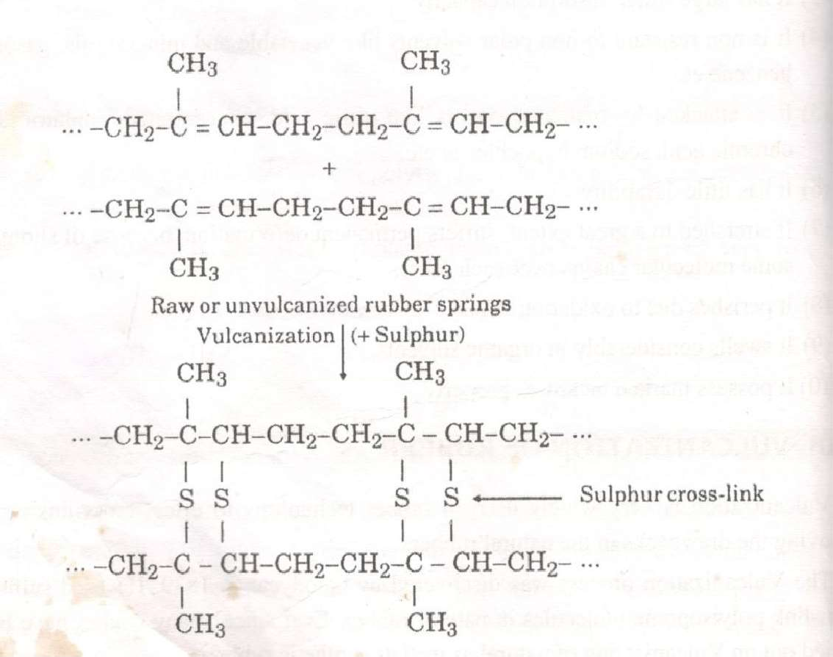

Slide 63
Unit No: 1 Unit name:Applied Chemistry-1
Lecture No: 9
Buna–S & Silicon Rubber

Slide 64
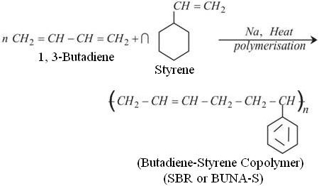
Buna-S Or Styrene Rubber Preperation

Slide 65
Properties :
It posses high abrasion resistance , high load bearing capacity and resilience.
It gets oxidized in the presence of traces of ozone.
It swells in oil and solvents.
Uses
It is used in the manufacturing of motor tyres.
It is used for floor tiles , shoe soles, wire and cable insulation , footwear components , adhesives , etc.

Slide 66
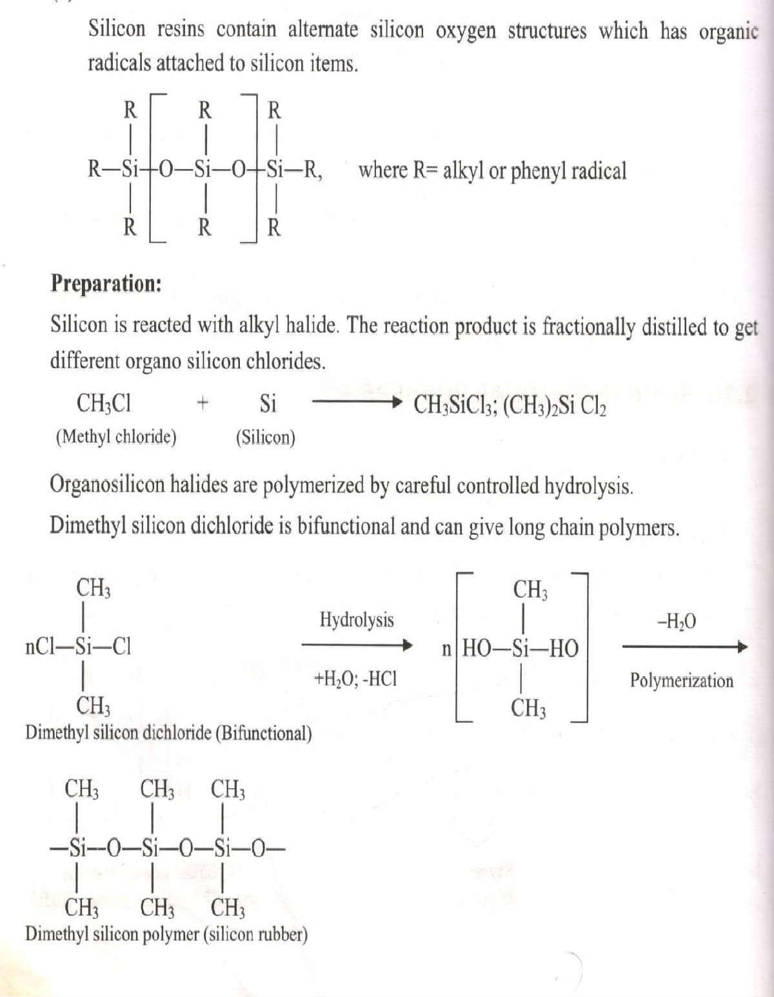
SILICONE RUBBER
Mrs. Rupal Agme-Jadhav (Ph.D.)

Slide 67
Unit No: 1 Unit name:Applied Chemistry-1
Lecture No: 10 Polyurathane Rubber

Slide 68
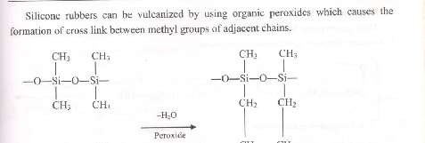
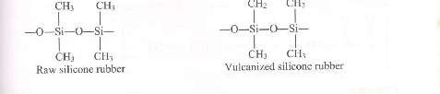
Notes by: Rupal Agme-Jadhav (Ph.D.)

Slide 69
Properties
They are stable to heat in temperature range 50-300 C .
They are chemically inert .
They posses electrical insulation
They posses water repellent character.
They are abrasion resistant.
They are resistant to ozone , U.V. light, solvents.
They are costly.
Their tensile strength can be increased by vulcanization .
USES
As a sealing material in search light in aircraft engines.
For insulating the electrical wiring in ships .
An adhesive in electronics industry .
For making artificial heart valves , transfusion tubing and padding for plastic surgery.
For manufacturing of tires for fighter aircrafts.
Notes by: Rupal Agme-Jadhav (Ph.D.)

Slide 70


POLYURETHANE
70
Notes by

Slide 71
Properties:
Because of their saturated character they are highly resistant to oxidation .
They are less stable at elevated temp.
They are good resistance to abrasion and organic solvents.
They are attacked by conc. And hot acids and alkali.
Uses:
Used as substitute for leather.
Used to produce gaskets, and seals.
Resilient polyurethane fibres are used for foundation garments and swim suits.
Used as adhesive , coatings films, foams etc.
71

Slide 72
Thank You

